Slide 1
Current Trends of Web Development

Slide 2
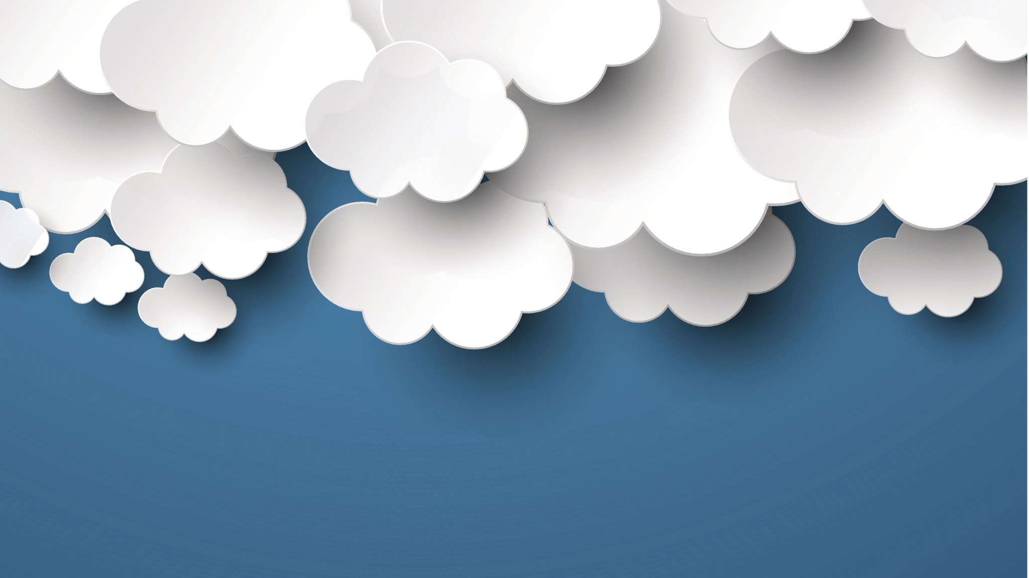
The Continued Rise of Cloud Computing

Slide 3

What is the cloud?

Slide 4


The Cloud
That which we call “the Cloud” actually refers to servers that can be accessed from all corners of the internet. These cloud servers are brought to life by data centers all over the world. By using the cloud companies do not require their own physical servers. They also don’t need to run software applications on their own machines.
Although similar ideas have been around for a long time the cloud didn’t actually become a thing until the mid 1990’s.
Google and Microsoft were at each others throats to see who could build a bigger market for this new virtual environment.

Slide 5

Examples of Cloud based applications.
Slack
Slack is a collaboration tool for teams and companies. Slack channels are essentially group messages and can be organized by individual, team, project, topic, etc.
2. Zoom
Zoom is a cloud-based software platform for audio and video conferencing that records meetings and saves them to the cloud so users can have access to them anytime, anywhere.
Notes:
hello

Slide 6
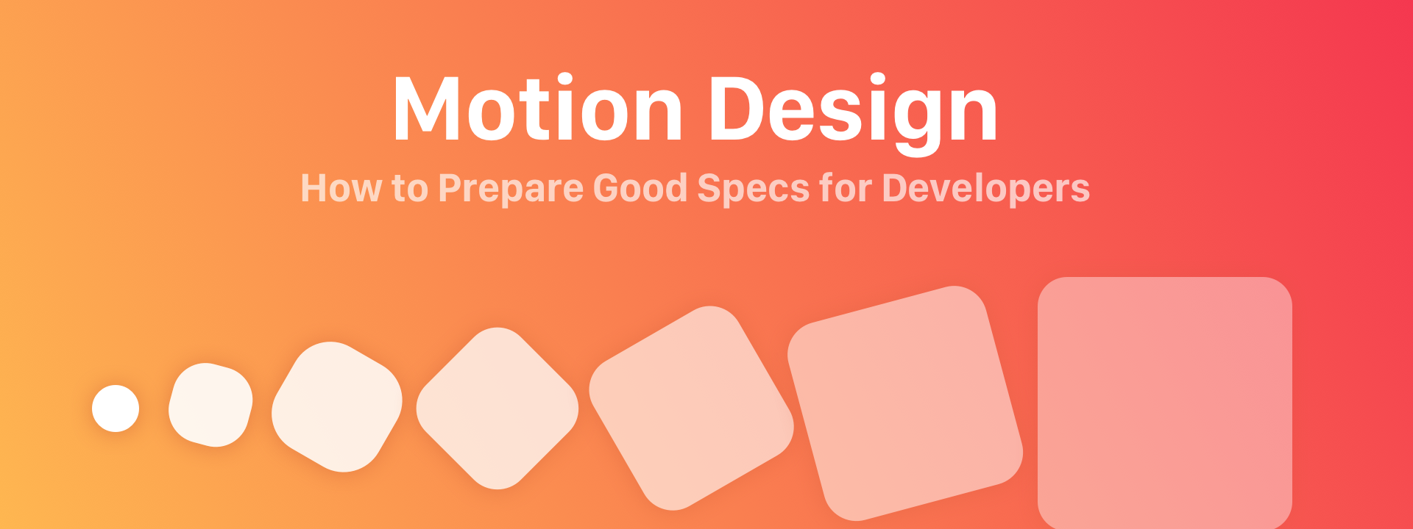
Motion UI Design

Slide 7
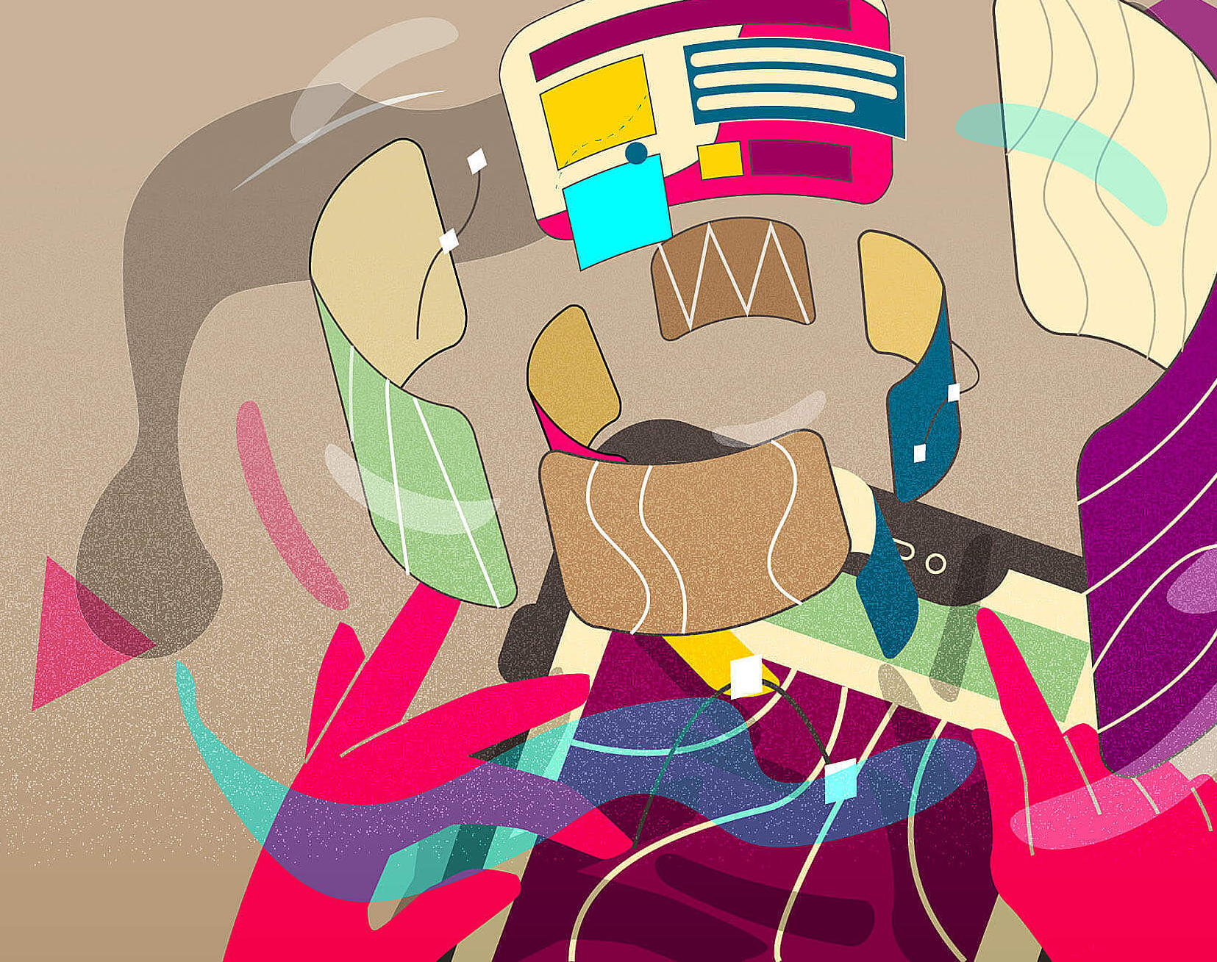
Motion UI design
Motion design boost page interactivity by creating an aesthetically pleasing and intuitive interface that will guide the user to where they need to go.
Animations are an important tool for motion design and a great way to keep users engaged. If a user is engaged in your site they will stay longer and return later.

Slide 8
Motion UI design example
Notice how the design team for google translate use simple animations to focus the user’s attention to on piece of information at a time.

Slide 9

Cybers security

Slide 10

Cyber security
Cybersecurity has been and always will be a never ending battle. according to Cloudflare Just in the last year the amount of Ddos attacks on businesses has doubled each quarter. This proves that protecting your websites and applications will be even more necessary in the coming years.

Slide 11

Main types of cyber security
Critical infrastructure security.
Application security
Network security
Cloud security
Internet of things (IoT) security

Slide 12

My Thoughts?
Notes:
I believe that cloud based applications are only going to get better and better as time goes on. Because of the current pandemic more and more people are starting to realize that with the right tools Schools can continue teaching and businesses can continue doing business. Cloud based technology allows us all to stay connected during these trying times. And that’s what is most important.

Slide 13
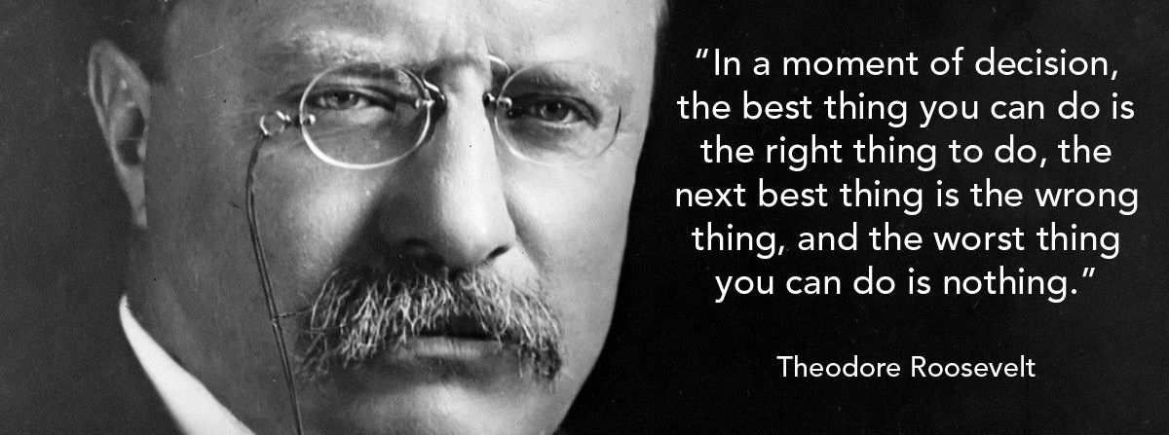
The End

